Slide 1
Synthetic Aperture Radar Interferometry (InSAR) basic concepts
N. d’Oreye^{1,2}
¹ European Center for Geodynamics and Seismology, Luxembourg
² National Museum of Natural History, Luxembourg

Slide 2
Plan
What is a radar image (SAR) ?
Radar interferometry (InSAR)
Time series (PSI or [M]SBAS)
Amplitude Time series

Slide 3
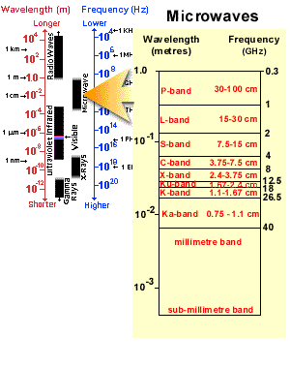
What is a SAR image?
Hyperspectral (1mm < λ < 1m) => All weather
Own illumination source => night & day

Slide 4
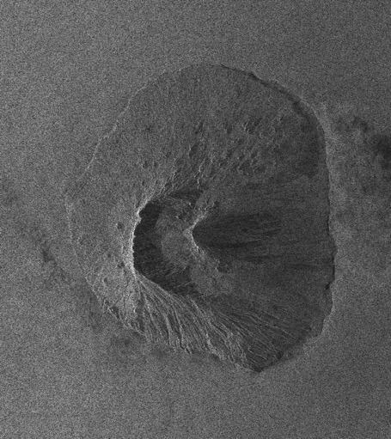
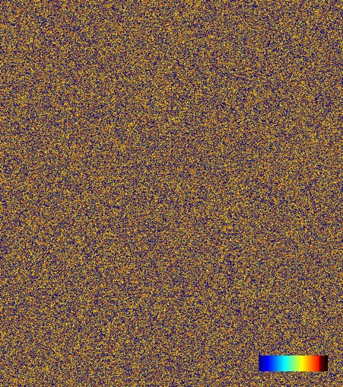
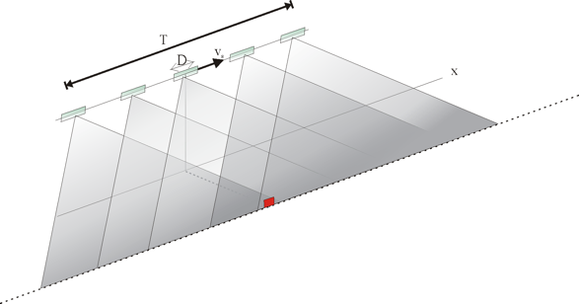
What is a SAR image?
Amplitude
Phase
Hyperspectral (1mm < λ < 1m) => All weather
Own illumination source => night & day
Radar image => Amplitude and phase
- π + π
To increase the spatial resolution :
Simulate larger antenna by taking advantage of satellite displacement (Synthetic Aperture Radar)
Fogo Island (Cape Verde), Aug. 9th 2005, Envisat ASAR
ENVISAT: 1 pixel = 5 x 25m
= resolution of a 2.2 km long antenna !

Slide 5
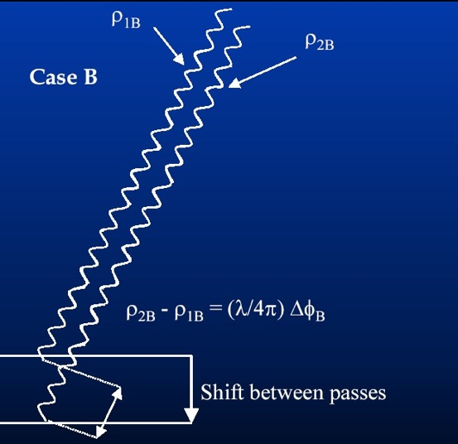
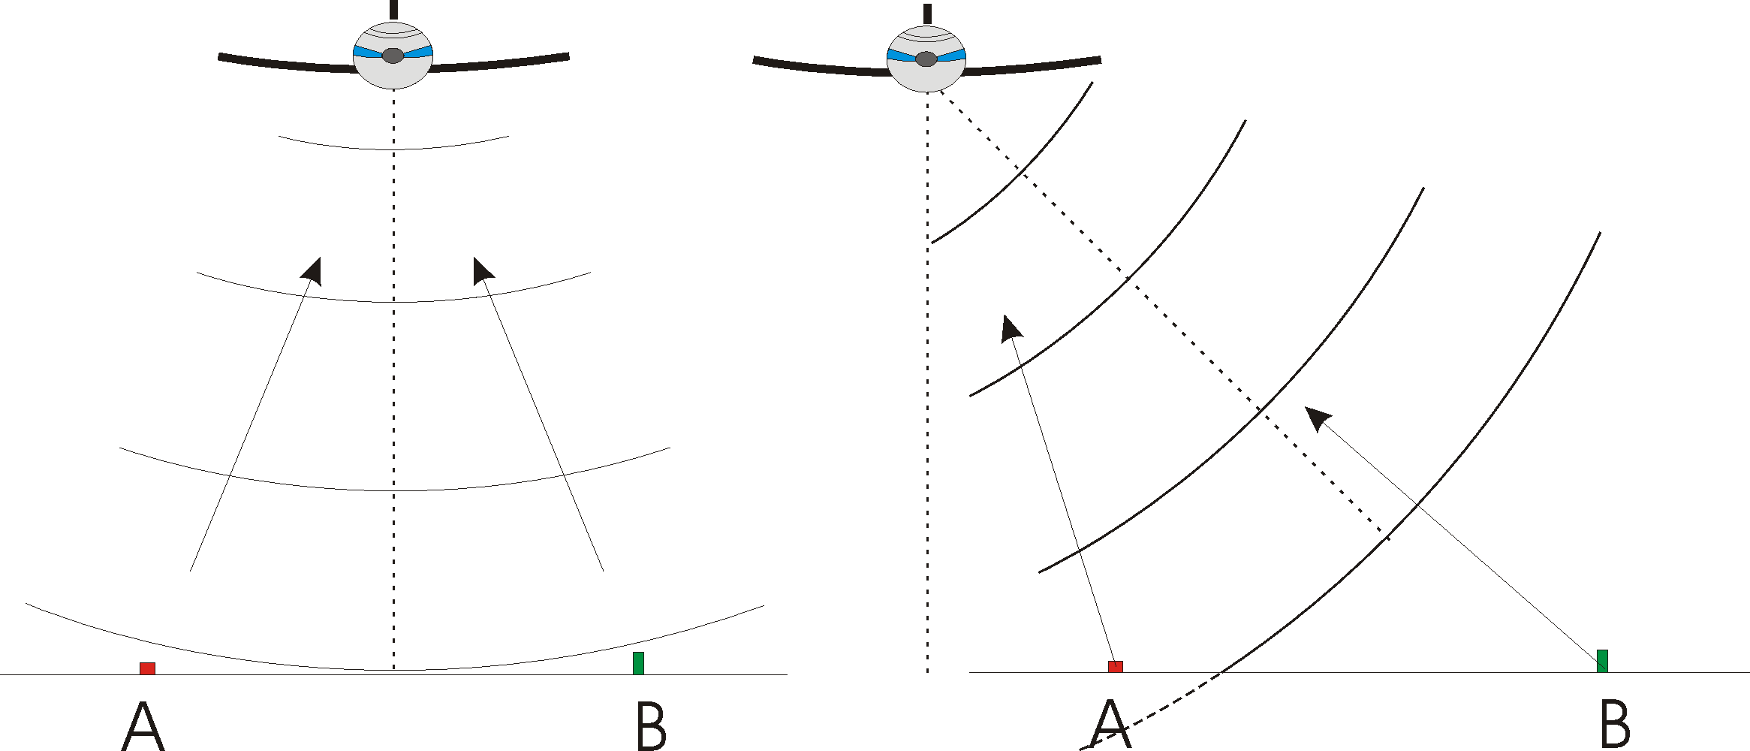
What is a SAR image?
Phase => information about distance, thought needs oblique viewing geometry
A and B at same distance from the sensor = same on image

Slide 6
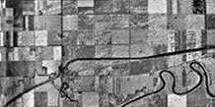
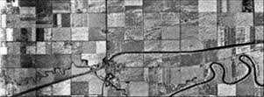
What is a SAR image?
Side view ➔ image distorsions
Optical imagery: measures angles
Radar: measures distances
Image time-range (or slant-r ange)
Image ground-range

Slide 7
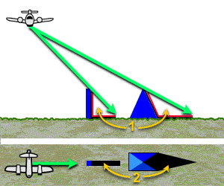
What is a SAR image?
Side view➔ shadowing
Area invisible from satellite

Slide 8
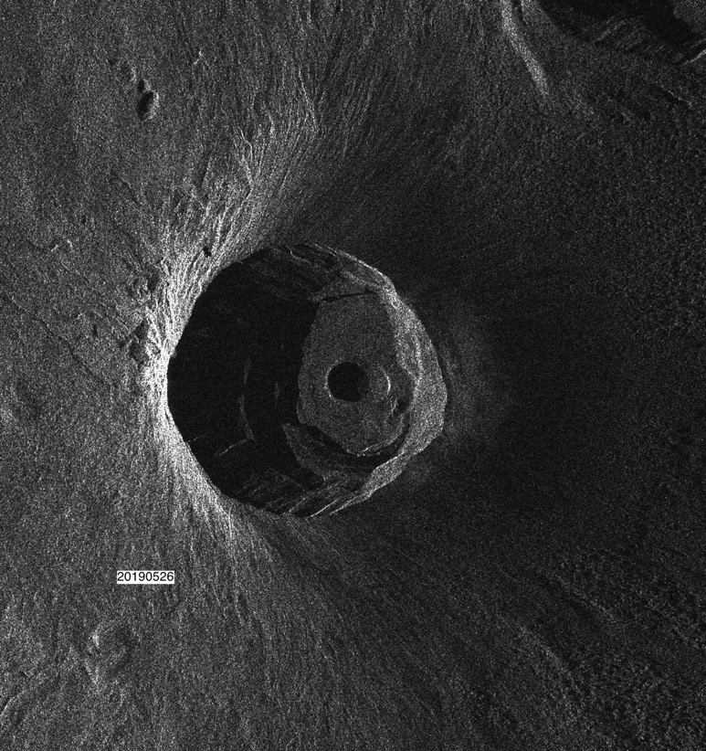
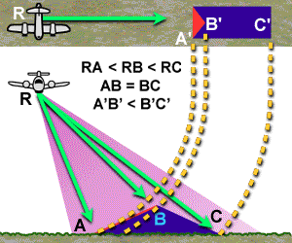
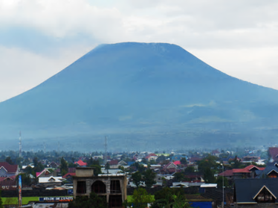
What is a SAR image?
Topography => Shortening
A-B
B-C

Slide 9
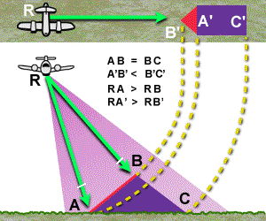
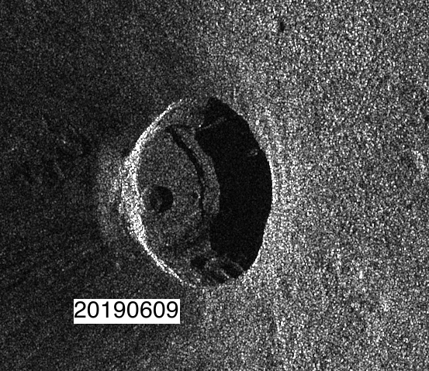
What is a SAR image?
Topography => Layover

Slide 10
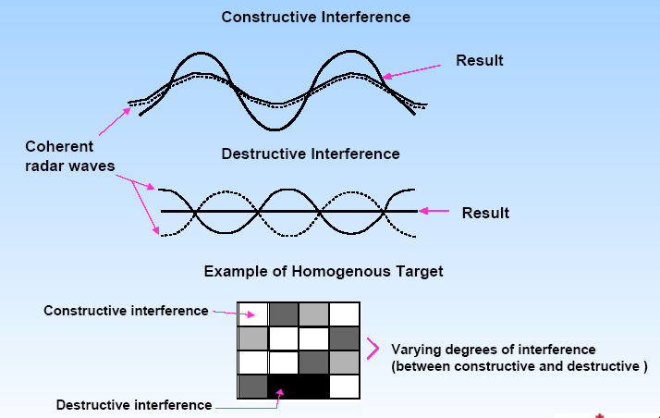
The speckle in radar images
The signal backscattered by a pixel is formed by the ensemble of the elementary and random reflectors

Slide 11
Plan
What is a radar image (SAR) ?
Radar interferometry (InSAR)
Time series (PSI or [M]SBAS)
Amplitude Time series

Slide 12
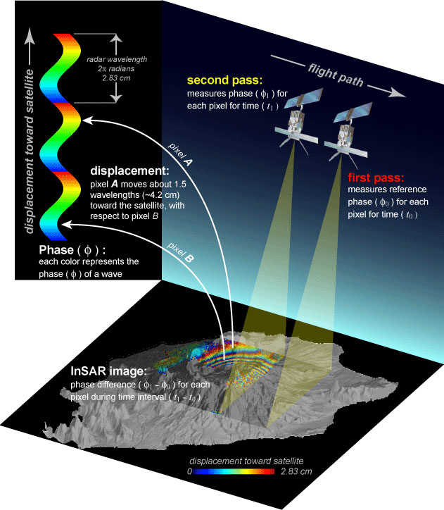
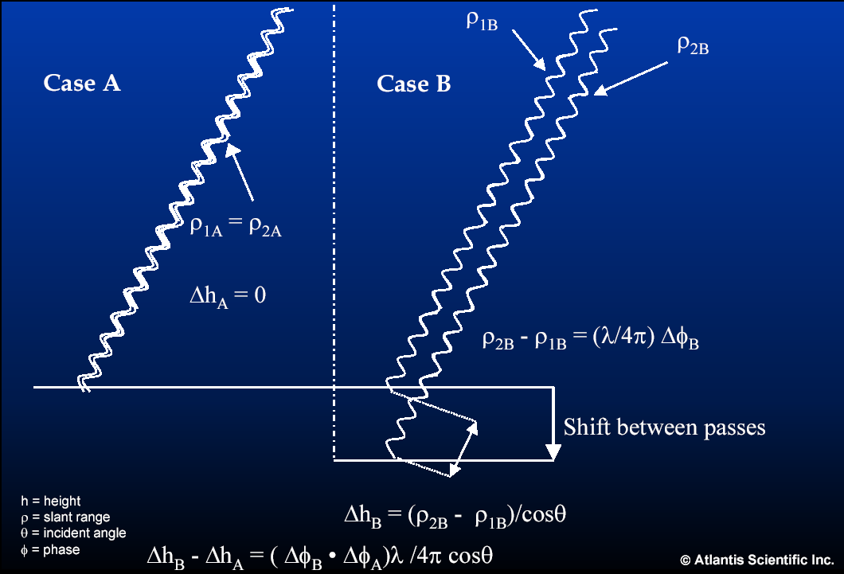
InSAR method
Interferometry between 2 RADAR signals
1 fringe = λ / 2 ~ 3cm (in C-band)

Slide 13
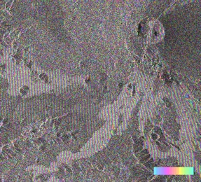
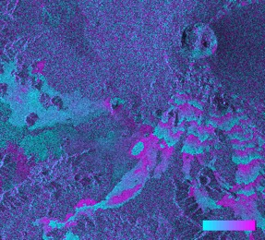
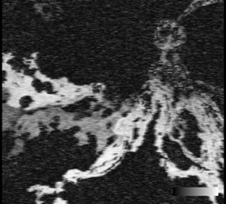
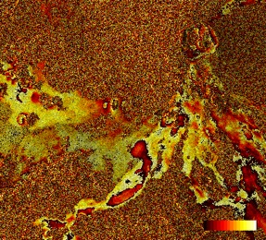
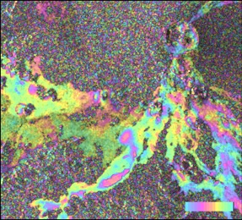
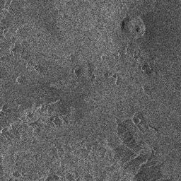
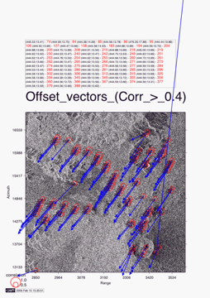
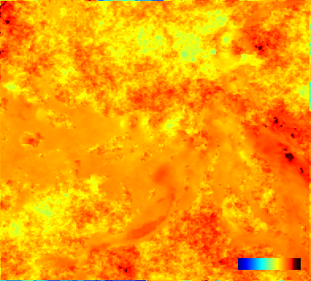
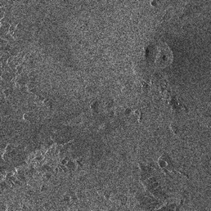
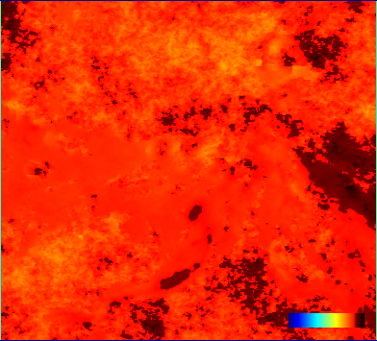
InSAR method
Interfero
ref phase
Coherence
-MNT
2 RADAR images => deformations
Filter
Primary SLC
Coregistration
Unwrap
Secondary SLC
Geocode
Unwrapping

Slide 14
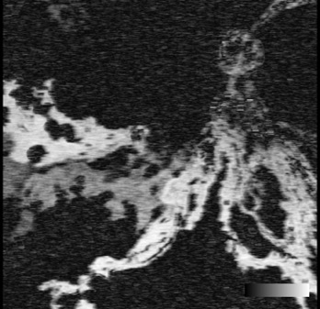
Coherence
Interferometry :
Mandatory to compare « similar » images, i.e. same geometry (Ascending/Descending, incidence angle, wavelength etc…).
0 < Coherence < 1
Not only !
InSAR does not work if:
The signal is not backscattered toward the satellite (specular reflexion on water)
The backscattering surfaces/properties have changed (vegetation, snow, anthropogenic activities…) => Max temporal Baseline (Bt)
If the point of view has changed => Max spatial Baseline (Bp). Cfr orbital tube.

Slide 15
Plan
What is a radar image (SAR) ?
Radar interferometry (InSAR)
Time series (PSI or [M]SBAS)
Amplitude Time series

Slide 16
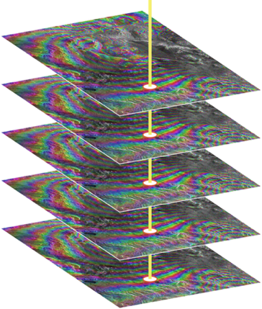
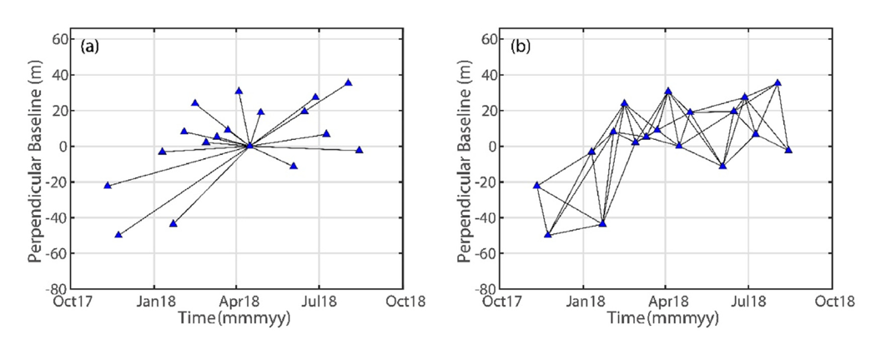
InSAR Times series:
Track displacement through « all » compatible pairs, i.e. same satellite, same geometry, same polarisation...
Two type of methods
Permanent Scatterer Interferometry (PSI):
Search for “worst” Bp to keep only good scatterers (usually man-made structures)
Better for urban regions
Small Baseline Subsets (SBAS)
Keep only the most favourable (shortests) Bt and Bp to ensure the best coherence
Appropriate for natural targets
Example baseline plot for (a) the PSI and (b) SBAS method (Li et al. 2022).

Slide 17
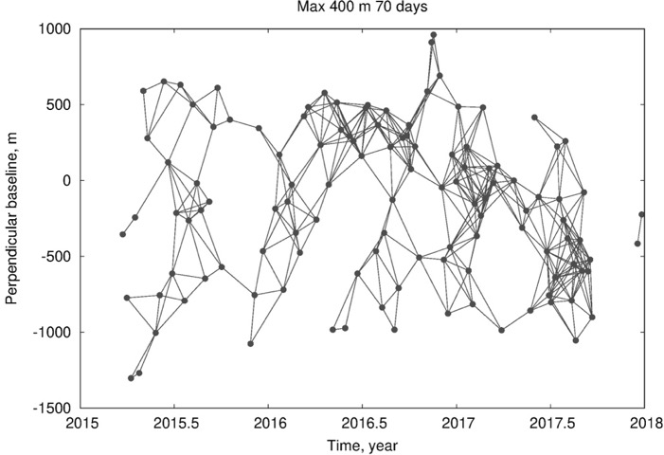
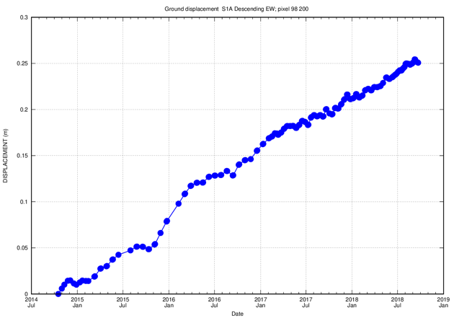
InSAR Times series:
SBAS :
< Max Bt (eg. max 70 days)
< Max Bp (eg. max 400 m)
Provides with mean linear velocity map and time series
of ground displacements in satellite Line Of Sight
Bp
Displacement (m)
Bt
n images => m interferograms (maximum (n-n²)/2)
Date

Slide 18
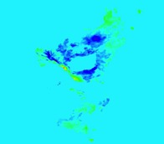
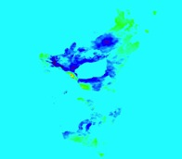
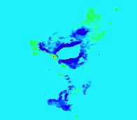
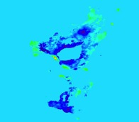
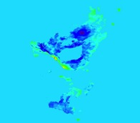
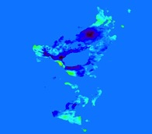
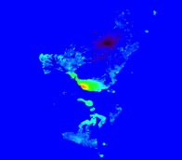
InSAR Times series:
For a given geometry (look angle, wave length, polarity…): The Small Baseline Subset (SBAS) method
(Berardino et al. 2002; Usai, 2003).
n images => m interferograms
m interferograms
A: time matrix V: Unknown velocities Ф: Observed interferograms
Singular Value Decompos. is used for finding a solution of under-/over-determined problem (A⁺).
n cumulated deformation maps
d^{i} (LOS)
n points
Time
d : LOS displacements

Slide 19
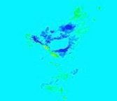
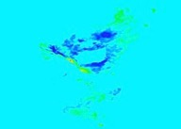
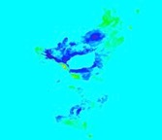
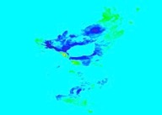

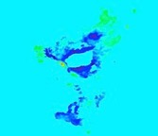
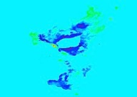
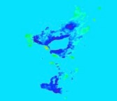


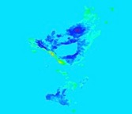

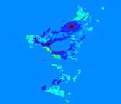
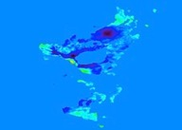

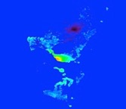


InSAR Times series:
Combining all geometries : The Multidimensional Small Baseline Subset (MSBAS) method.
(Samsonov and d’Oreye, 2012, 2017)
d^{i} (LOS)
d^{j} (LOS)
d^{k} (LOS)
Time
Time
Time
Subpolar Orbits => Usually not sensitive to motion in NS direction (OK if V_{N} not >> V_{E})
Horiz. displ.
Vert. displ.
Time
Time

Slide 20




















InSAR Times series:
Combining all geometries : The Multidimensional Small Baseline (MSBAS) method.
(Samsonov and d’Oreye, 2012, 2017)
For each of the k=1,2,… K datasets:
k
k
k
A: time matrix V: Unknown velocities Ф: Observed interferograms
V_{los} = VS = S_{N}V_{N} + S_{E}V_{E} + S_{U}V_{U},
where V_{los} = line-of-sight scalar velocity V = velocity vector V (V_{N}, V_{E},V_{U}) S = unit vector S (S_{N}, S_{E},S_{U}) pointing to the satellite
For all K datasets:
d^{i} (LOS)
d^{j} (LOS)
d^{k} (LOS)
Time
Time
Time
or
Horiz. displ.
Vert. displ.
Time
Time

Slide 21



InSAR Times series:
cm/yr (Eastward)
BUK GNSS station
0
9.66
Places
3D Capabilities
Lake Kivu
(Samsonov et al., Eng. Geol. 2020)

Slide 22




MSBAS operates with all type of SAR
Several existing SAR satellites and constellations of satellites (and more to come !)
Several type of geometries (Ascending, Descending, incidence angle, λ, polarisation, resolution etc.. )
ALOSa 1 & 2
RADARSAT 1, 2 &
Constellation
TerraSarX-TanDemX
CosmoSkyMed
1, 2 ,3 & 4
ERS 1 & 2
ENVISAT
SENTINEL-1
A, B, (C & D)
PAZ SAOCOM
KOMPSAT
ICEYE…

Slide 23
Limitations:
Mandatory conditions:
Coherence: ➔ limited vegetation, same ground conditions
Diversity of looking angle for 2D/3D decomposition ➔ Ascending and Descending
Appropriate selection of processing parameters, reference points for MSBAS inversion…
Appropriate pair selection (no gaps, balanced use of images as Primary and Secondary…)

Slide 24
Plan
What is a radar image (SAR) ?
Radar interferometry (InSAR)
Time series (PSI or [M]SBAS)
Amplitude Time series

Slide 25


Information from the amplitude images
Nyiragongo crater – RS2 UF (2012-2019)
(Barrière et al. 2018, 2019)

Slide 26

Nyiragongo
Lava lake depth
Crater depth
=> Accumulated volume, pressure changes…

